Slide 1
Unit 2:
2.1 Cellular Wireless Networks

Slide 2
Principles of Cellular Networks
Principles of Cellular Networking
Underlying technology for mobile phones, personal communication systems, wireless networking etc.
Developed for mobile radio telephone
Replace high power transmitter/receiver systems
Typical support for 25 channels over 80km
Use lower power, shorter range, more transmitters

Slide 3
Cellular Network Organization
Area divided into cells
Each with own antenna
Each with own range of frequencies
Served by base station
Transmitter, receiver, control unit
Adjacent cells on different frequencies to avoid crosstalk

Slide 4


Shape of Cells
Square
Width d cell has four neighbors at distance d and foura at distance d
Better if all adjacent antennas equidistant
Simplifies choosing and switching to new antenna
Hexagon
Provides equidistant antennas
Radius defined as radius of circum-circle
Distance from center to vertex equals length of side
Distance between centers of cells radius R is R
Not always precise hexagons
Topographical limitations
Local signal propagation conditions
Location of antennas

Slide 5
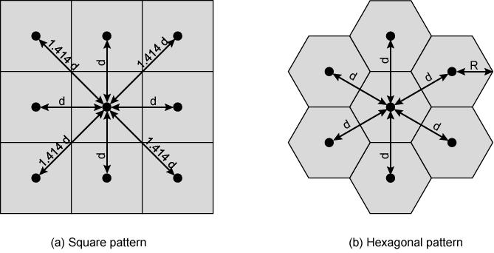
Cellular Geometries

Slide 6
Characterizing Frequency Reuse
D = minimum distance between centers of cells that use the same band of frequencies (called cochannels)
R = radius of a cell
d = distance between centers of adjacent cells (d = R)

Slide 7
Operation of Cellular Systems
Base station (BS) at center of each cell
Antenna, controller, transceivers
Controller handles call process
Number of mobile units may in use at a time
BS connected to mobile telecommunications switching office (MTSO)
One MTSO serves multiple BS
MTSO to BS link by wire or wireless
MTSO:
Connects calls between mobile units and from mobile to fixed telecommunications network
Assigns voice channel
Performs handoffs
Monitors calls (billing)
Fully automated

Slide 8
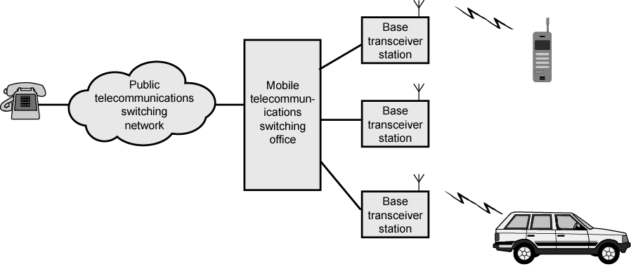
Overview of Cellular System

Slide 9
Channels
Control channels
Setting up and maintaining calls
Establish relationship between mobile unit and nearest BS
Traffic channels
Carry voice and data

Slide 10
Typical Call in Single MTSO Area (1)
Mobile unit initialization
Scan and select strongest set up control channel
Automatically selected BS antenna of cell
Usually but not always nearest (propagation anomalies)
Handshake to identify user and register location
Scan repeated to allow for movement
Change of cell
Mobile unit monitors for pages (see below)
Mobile originated call
Check set up channel is free
Monitor forward channel (from BS) and wait for idle
Send number on pre-selected channel
Paging
MTSO attempts to connect to mobile unit
Paging message sent to BSs depending on called mobile number
Paging signal transmitted on set up channel

Slide 11
Typical Call in Single MTSO Area (2)
Call accepted
Mobile unit recognizes number on set up channel
Responds to BS which sends response to MTSO
MTSO sets up circuit between calling and called BSs
MTSO selects available traffic channel within cells and notifies BSs
BSs notify mobile unit of channel
Ongoing call
Voice/data exchanged through respective BSs and MTSO
Handoff
Mobile unit moves out of range of cell into range of another cell
Traffic channel changes to one assigned to new BS
Without interruption of service to user

Slide 12
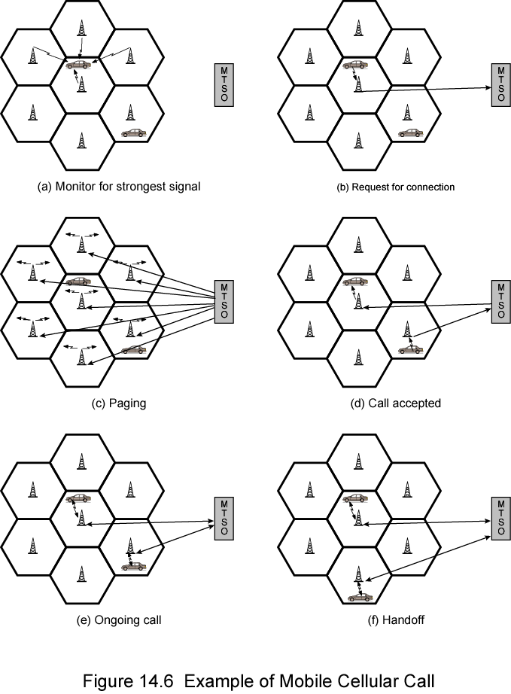
Call Stages

Slide 13
Other Functions
Call blocking
During mobile-initiated call stage, if all traffic channels busy, mobile tries again
After number of fails, busy tone returned
Call termination
User hangs up
MTSO informed
Traffic channels at two BSs released
Call drop
BS cannot maintain required signal strength
Traffic channel dropped and MTSO informed
Calls to/from fixed and remote mobile subscriber
MTSO connects to PSTN
MTSO can connect mobile user and fixed subscriber via PSTN
MTSO can connect to remote MTSO via PSTN or via dedicated lines
Can connect mobile user in its area and remote mobile user

Slide 14
Mobile Radio Propagation Effects
Signal strength
Strength of signal between BS and mobile unit strong enough to maintain signal quality at the receiver
Not strong enough to create too much co channel interference
Noise varies
Automobile ignition noise greater in city than in suburbs
Other signal sources vary
Signal strength varies as function of distance from BS
Signal strength varies dynamically as mobile unit moves
Fading
Even if signal strength in effective range, signal propagation effects may disrupt the signal

Slide 15
Design Factors
Propagation effects
Dynamic
Hard to predict
Maximum transmit power level at BS and mobile units
Typical height of mobile unit antenna
Available height of the BS antenna
These factors determine size of individual cell
Model based on empirical data
Apply model to given environment to develop guidelines for cell size
E.g. model by Okumura et al refined by Hata
Detailed analysis of Tokyo area
Produced path loss information for an urban environment
Hata's model is an empirical formulation
Takes into account variety of environments and conditions

Slide 16
Fading
Time variation of received signal
Caused by changes in transmission path(s)
E.g. atmospheric conditions (rain)
Movement of (mobile unit) antenna

Slide 17
Multipath Propagation
Reflection
Surface large relative to wavelength of signal
May have phase shift from original
May cancel out original or increase it
Diffraction
Edge of impenetrable body that is large relative to wavelength
May receive signal even if no line of sight (LOS) to transmitter
Scattering
Obstacle size on order of wavelength
Lamp posts etc.
If LOS, diffracted and scattered signals not significant
Reflected signals may be
If no LOS, diffraction and scattering are primary means of reception

Slide 18
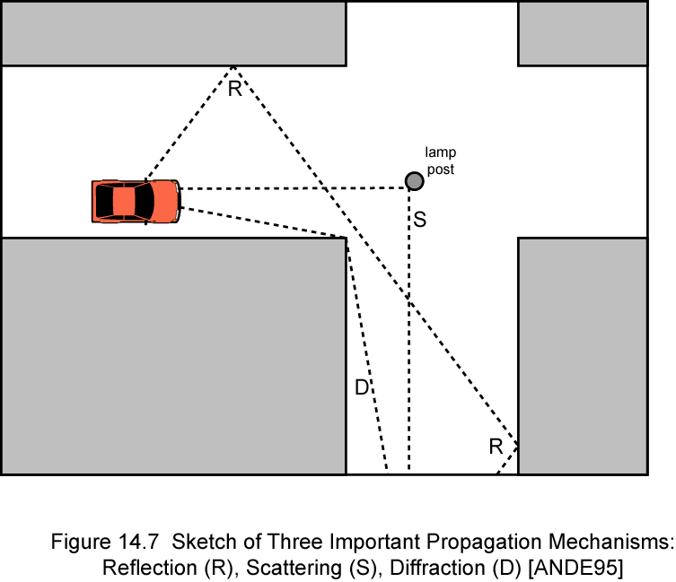
Reflection, Diffraction, Scattering

Slide 19
Types of Fading
Fast fading
Rapid changes in strength over distances about half wavelength
900MHz wavelength is 0.33m
Slow fading
Slower changes due to user passing different height buildings, gaps in buildings etc.
Over longer distances than fast fading
Flat fading
Nonselective
Affects all frequencies in same proportion
Selective fading
Different frequency components affected differently

Slide 20
First Generation Analog
Original cellular telephone networks
Analog traffic channels
Early 1980s in North America
Advanced Mobile Phone Service (AMPS)
AT&T
Also common in South America, Australia, and China

Slide 21
Spectral Allocation In North America
Two 25-MHz bands are allocated to AMPS
One from BS to mobile unit (869–894 MHz)
Other from mobile to base station (824–849 MHz)
Bands is split in two to encourage competition
In each market two operators can be accommodated
Operator is allocated only 12.5 MHz in each direction
Total of 416 channels per operator
21 channels allocated for control
395 to carry calls
Control channels are 10 kbps data channels
Conversation channels carry analog using frequency modulation
Control information also sent on conversation channels in bursts as data

Slide 22
Operation
AMPS-capable phone has numeric assignment module (NAM) in read-only memory
NAM contains number of phone
Assigned by service provider
Serial number of phone
Assigned by the manufacturer
When phone turned on, transmits serial number and phone number to MTSO
MTSO has database of mobile units reported stolen
Uses serial number to lock out stolen units
MTSO uses phone number for billing
If phone is used in remote city, service is still billed to user's local service provider

Slide 23
Call Sequence
Subscriber initiates call by keying in number and presses send
MTSO validates telephone number and checks user authorized to place call
Some service providers require a PIN to counter theft
MTSO issues message to user's phone indicating traffic channels to use
MTSO sends ringing signal to called party
All operations, 2 through 4, occur within 10 s of initiating call
When called party answers, MTSO establishes circuit and initiates billing information
When one party hangs up MTSO releases circuit, frees radio channels, and completes billing information

Slide 24
Second Generation CDMA
Higher quality signals
Higher data rates
Support of digital services
Greater capacity
Digital traffic channels
Support digital data
Voice traffic digitized
User traffic (data or digitized voice) converted to analog signal for transmission
Encryption
Simple to encrypt digital traffic
Error detection and correction
(See chapter 6)
Very clear voice reception
Channel access
Channel dynamically shared by users via Time division multiple access (TDMA) or code division multiple access (CDMA)

Slide 25
Code Division Multiple Access
Each cell allocated frequency bandwidth
Split in two
Half for reverse, half for forward
Direct-sequence spread spectrum (DSSS) (see chapter 9)

Slide 26
Code Division Multiple Access Advantages
Frequency diversity
Frequency-dependent transmission impairments (noise bursts, selective fading) have less effect
Multipath resistance
DSSS overcomes multipath fading by frequency diversity
Also, chipping codes used only exhibit low cross correlation and low autocorrelation
Version of signal delayed more than one chip interval does not interfere with the dominant signal as much
Privacy
From spread spectrum (see chapter 9)
Graceful degradation
With FDMA or TDMA, fixed number of users can access system simultaneously
With CDMA, as more users access the system simultaneously, noise level and hence error rate increases
Gradually system degrades

Slide 27
Code Division Multiple Access
Self-jamming
Unless all mobile users are perfectly synchronized, arriving transmissions from multiple users will not be perfectly aligned on chip boundaries
Spreading sequences of different users not orthogonal
Some cross correlation
Distinct from either TDMA or FDMA
In which, for reasonable time or frequency guardbands, respectively, received signals are orthogonal or nearly so
Near-far problem
Signals closer to receiver are received with less attenuation than signals farther away
Given lack of complete orthogonality, transmissions from more remote mobile units may be more difficult to recover

Slide 28
RAKE Receiver
If multiple versions of signal arrive more than one chip interval apart, receiver can recover signal by correlating chip sequence with dominant incoming signal
Remaining signals treated as noise
Better performance if receiver attempts to recover signals from multiple paths and combine them, with suitable delays
Original binary signal is spread by XOR operation with chipping code
Spread sequence modulated for transmission over wireless channel
Multipath effects generate multiple copies of signal
Each with a different amount of time delay (τ1, τ2, etc.)
Each with a different attenuation factors (a1, a2, etc.)
Receiver demodulates combined signal
Demodulated chip stream fed into multiple correlators, each delayed by different amount
Signals combined using weighting factors estimated from the channel

Slide 29
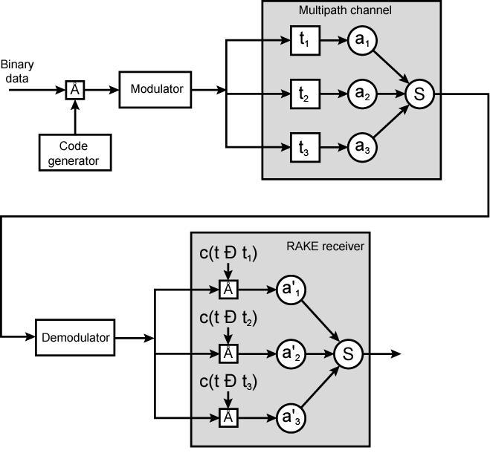
Principle of RAKE Receiver

Slide 30
IS-95
Second generation CDMA scheme
Primarily deployed in North America
Transmission structures different on forward and reverse links

Slide 31
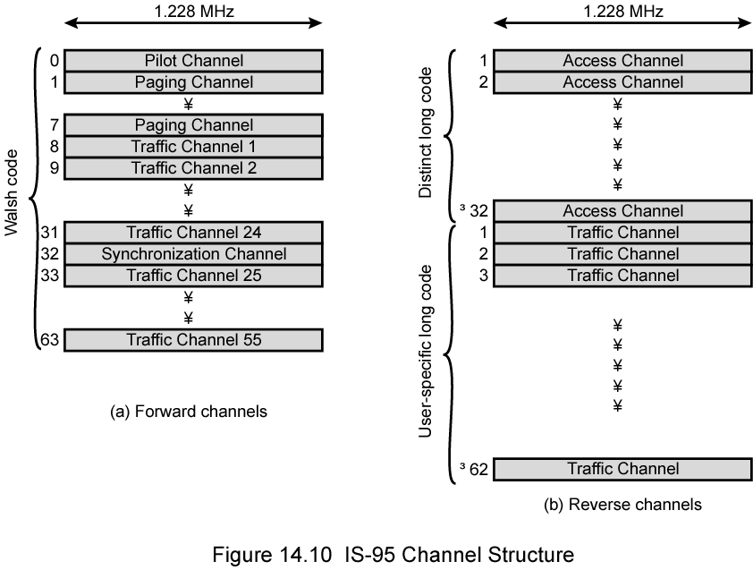
IS-95 Channel Structure

Slide 32
IS-95 Forward Link (1)
Up to 64 logical CDMA channels each occupying the same 1228-kHz bandwidth
Four types of channels:
Pilot (channel 0)
Continuous signal on a single channel
Allows mobile unit to acquire timing information
Provides phase reference for demodulation process
Provides signal strength comparison for handoff determination
Consists of all zeros
Synchronization (channel 32)
1200-bps channel used by mobile station to obtain identification information about the cellular system
System time, long code state, protocol revision, etc.

Slide 33
IS-95 Forward Link (2)
Paging (channels 1 to 7)
Contain messages for one or more mobile stations
Traffic (channels 8 to 31 and 33 to 63)
55 traffic channels
Original specification supported data rates of up to 9600 bps
Revision added rates up to 14,400 bps
All channels use same bandwidth
Chipping code distinguishes among channels
Chipping codes are the 64 orthogonal 64-bit codes derived from 64 × 64 Walsh matrix

Slide 34
Forward Link Processing
Voice traffic encoded at 8550 bps
Additional bits added for error detection
Rate now 9600 bps
Full capacity not used when user not speaking
Quiet period data rate as low as 1200 bps
2400 bps rate used to transmit transients in background noise
4800 bps rate to mix digitized speech and signaling data
Data transmitted in 20 ms blocks
Forward error correction
Convolutional encoder with rate ½
Doubling effective data rate to 19.2 kbps
For lower data rates encoder output bits (called code symbols) replicated to yield 19.2-kbps
Data interleaved in blocks to reduce effects of errors by spreading them

Slide 35
Scrambling
After interleaver, data scrambled
Privacy mask
Prevent sending of repetitive patterns
Reduces probability of users sending at peak power at same time
Scrambling done by long code
Pseudorandom number generated from 42-bit-long shift register
Shift register initialized with user's electronic serial number
Output of long code generator is at a rate of 1.2288 Mbps
64 times 19.2 kbps
One bit in 64 selected (by the decimator function)
Resulting stream XORed with output of block interleaver

Slide 36
Power Control
Next step inserts power control information in traffic channel
To control the power output of antenna
Robs traffic channel of bits at rate of 800 bps by stealing code bits
800-bps channel carries information directing mobile unit to change output level
Power control stream multiplexed into 19.2 kbps
Replace some code bits, using long code generator to encode bits

Slide 37
DSSS
Spreads 19.2 kbps to 1.2288 Mbps
Using one row of Walsh matrix
Assigned to mobile station during call setup
If 0 presented to XOR, 64 bits of assigned row sent
If 1 presented, bitwise XOR of row sent
Final bit rate 1.2288 Mbps
Bit stream modulated onto carrier using QPSK
Data split into I and Q (in-phase and quadrature) channels
Data in each channel XORed with unique short code
Pseudorandom numbers from 15-bit-long shift register

Slide 38
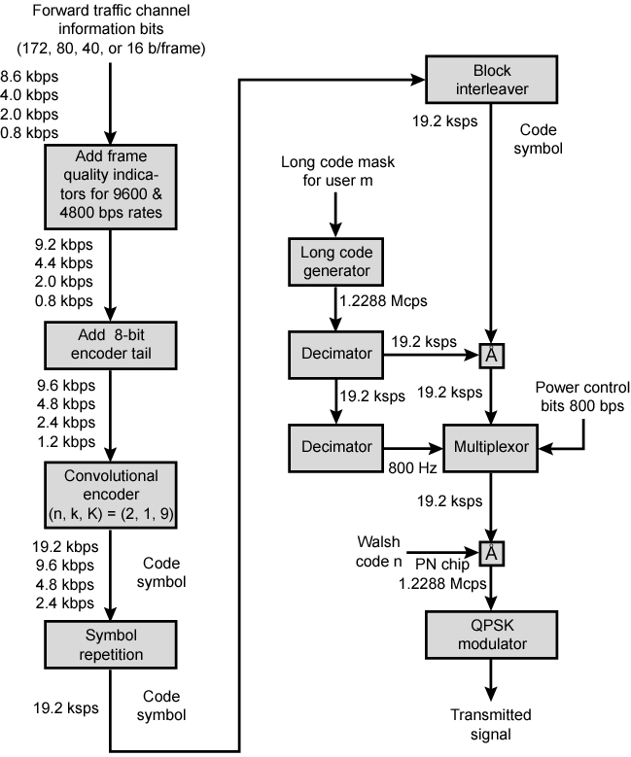
Forward Link Transmission

Slide 39
Reverse Link
Up to 94 logical CDMA channels
Each occupying same 1228-kHz bandwidth
Supports up to 32 access channels and 62 traffic channels
Traffic channels mobile unique
Each station has unique long code mask based on serial number
42-bit number, 2⁴² – 1 different masks
Access channel used by mobile to initiate call, respond to paging channel message, and for location update

Slide 40
Reverse Link Processing and Spreading
First steps same as forward channel
Convolutional encoder rate 1/3
Tripling effective data rate to max. 28.8 kbps
Data block interleaved
Spreading using Walsh matrix
Use and purpose different from forward channel
Data from block interleaver grouped in units of 6 bits
Each 6-bit unit serves as index to select row of matrix (2⁶ = 64)
Row is substituted for input
Data rate expanded by factor of 64/6 to 307.2 kbps
Done to improve reception at BS
Because possible codings orthogonal, block coding enhances decision-making algorithm at receiver
Also computationally efficient
Walsh modulation form of block error-correcting code
(n, k) = (64, 6) and d_{min} = 32
In fact, all distances 32

Slide 41
Data Burst Randomizer
Reduce interference from other mobile stations
Using long code mask to smooth data out over 20 ms frame

Slide 42
DSSS
Long code unique to mobile XORed with output of randomizer
1.2288-Mbps final data stream
Modulated using orthogonal QPSK modulation scheme
Differs from forward channel in use of delay element in modulator to produce orthogonality
Forward channel, spreading codes orthogonal
Coming from Walsh matrix
Reverse channel orthogonality of spreading codes not guaranteed

Slide 43
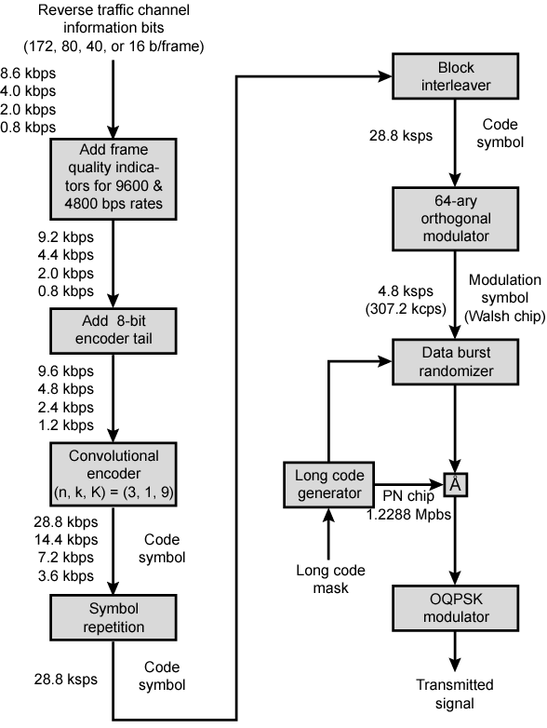
Reverse Link Transmission

Slide 44
Third Generation Systems
Objective to provide fairly high-speed wireless communications to support multimedia, data, and video in addition to voice
ITU’s International Mobile Telecommunications for the year 2000 (IMT-2000) initiative defined ITU’s view of third-generation capabilities as:
Voice quality comparable to PSTN
144 kbps available to users in vehicles over large areas
384 kbps available to pedestrians over small areas
Support for 2.048 Mbps for office use
Symmetrical and asymmetrical data rates
Support for packet-switched and circuit-switched services
Adaptive interface to Internet
More efficient use of available spectrum
Support for variety of mobile equipment
Flexibility to allow introduction of new services and technologies

Slide 45
Driving Forces
Trend toward universal personal telecommunications
Ability of person to identify himself and use any communication system in globally, in terms of single account
Universal communications access
Using one’s terminal in a wide variety of environments to connect to information services
e.g. portable terminal that will work in office, street, and planes equally well
GSM cellular telephony with subscriber identity module, is step towards goals
Personal communications services (PCSs) and personal communication networks (PCNs) also form objectives for third-generation wireless
Technology is digital using time division multiple access or code-division multiple access
PCS handsets low power, small and light

Slide 46
Alternative Interfaces (1)
IMT-2000 specification covers set of radio interfaces for optimized performance in different radio environments
Five alternatives to enable smooth evolution from existing systems
Alternatives reflect evolution from second generation
Two specifications grow out of work at European Telecommunications Standards Institute (ETSI)
Develop a UMTS (universal mobile telecommunications system) as Europe's 3G wireless standard
Includes two standards
Wideband CDMA, or W-CDMA
Fully exploits CDMA technology
Provides high data rates with efficient use of bandwidth
IMT-TC, or TD-CDMA
Combination of W-CDMA and TDMA technology
Intended to provide upgrade path for TDMA-based GSM systems

Slide 47
Alternative Interfaces (2)
CDMA2000
North American origin
Similar to, but incompatible with, W-CDMA
In part because standards use different chip rates
Also, cdma2000 uses multicarrier, not used with W-CDMA
IMT-SC designed for TDMA-only networks
IMT-FC can be used by both TDMA and FDMA carriers
To provide some 3G services
Outgrowth of Digital European Cordless Telecommunications (DECT) standard

Slide 48
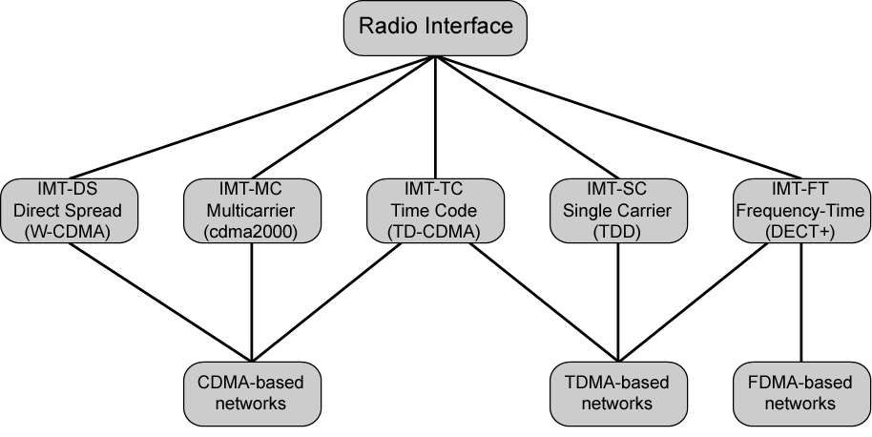
IMT-2000 Terrestrial Radio Interfaces

Slide 49
CDMA Design Considerations – Bandwidth and Chip Rate
Dominant technology for 3G systems is CDMA
Three different CDMA schemes have been adopted
Share some common design issues
Bandwidth
Limit channel usage to 5 MHz
Higher bandwidth improves the receiver's ability to resolve multipath
But available spectrum is limited by competing needs
5 MHz reasonable upper limit on what can be allocated for 3G
5 MHz is enoughfordata rates of 144 and 384 kHz
Chip rate
Given bandwidth, chip rate depends on desired data rate, need for error control, and bandwidth limitations
Chip rate of 3 Mcps or more reasonable

Slide 50
CDMA Design Considerations – Multirate
Provision of multiple fixed-data-rate logical channels to a given user
Different data rates provided on different logical channels
Traffic on each logical channel can be switched independently through wireless fixed networks to different destinations
Flexibly support multiple simultaneous applications from user
Efficiently use available capacity by only providing the capacity required for each service
Achieved with TDMA scheme within single CDMA channel
Different number of slots per frame assigned for different data rates
Subchannels at a given data rate protected by error correction and interleaving techniques
Alternative: use multiple CDMA codes
Separate coding and interleaving
Map them to separate CDMA channels

Slide 51
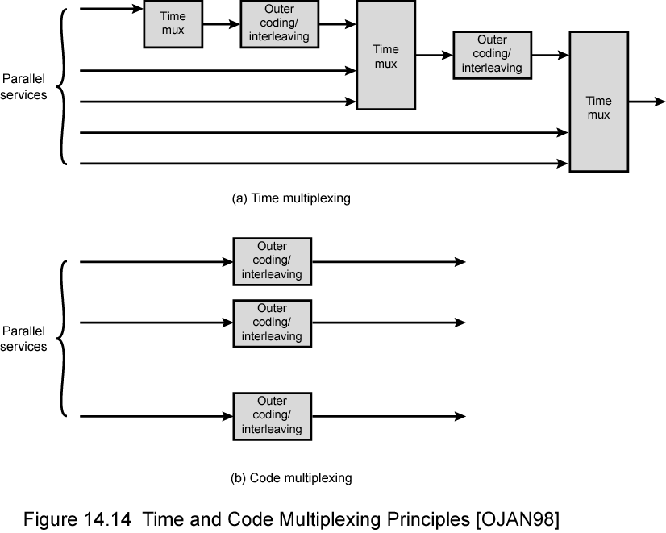
Time and Code Multiplexing

Slide 52
Required Reading
Stallings chapter 14
Web search on 3G mobile phones

